Slide 1
Solving Mazes
Troy Mahon

Slide 2
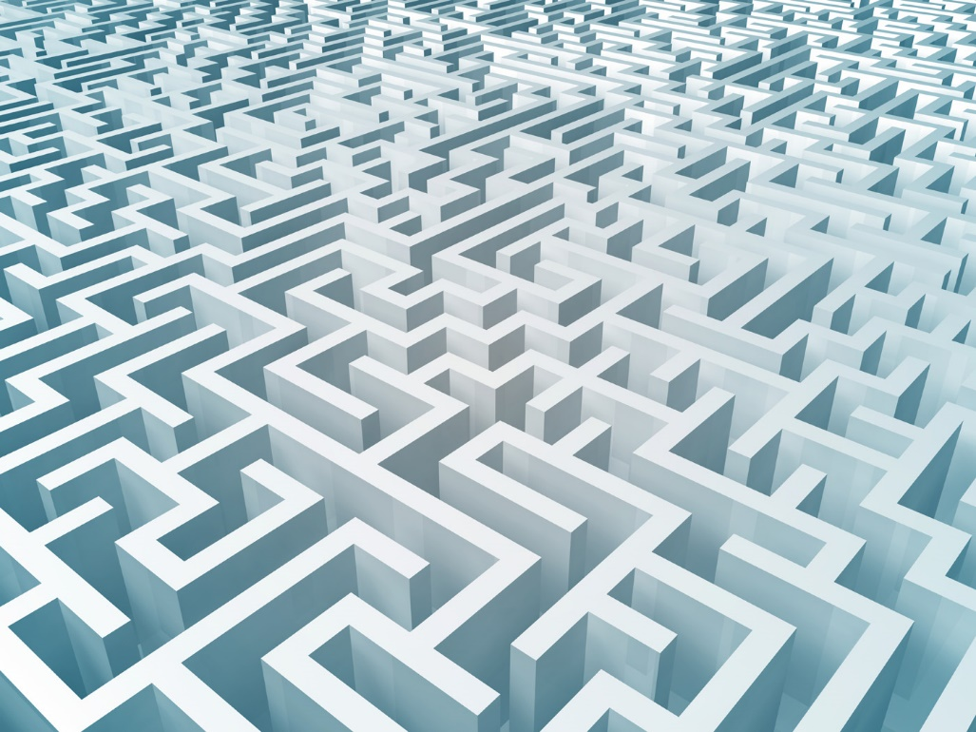
What is a Maze?
“An intricate, usually confusing network of interconnecting pathways…” (the Free Dictionary)
Many different kinds
Not all mazes can be solved the same way

Slide 3
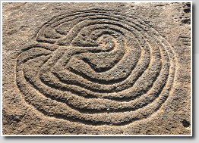
Brief History
Goa, India… 4,000 years ago…
Classical Labyrinth circle

Slide 4
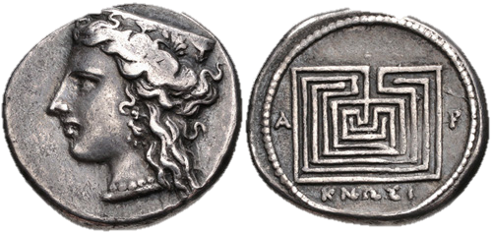
Brief History (Cont.)
"It is a confusing path, hard to follow without a thread, but, provided [you are] not devoured at the midpoint, it leads surely, despite twists and turns, back to the beginning." — Plato
c. 400 BCE

Slide 5
Different Types of Mazes (Routing)
Mazes vs. Labyrinth
  Labyrinth have no dead ends and usually don’t require choices
  One continues winding path
May or may not have dead ends
  Might just loop around somewhere else (called a “braid”)
Can have different dimensions
Simply connected or not (i.e. have islands or blocked off areas)

Slide 6
Higher Dimensional Mazes
A 3D Maze is a 2D Maze with different levels connected by a bridge/staircase
4D will have portals leading to different levels…

Slide 7
Weaves and Tessellation
Weaves are similar to highway overpasses
  Path can go under/over at certain place
Tessellation refers to the shape of an individual cell with a maze
  Square, triangular, irregular, etc.

Slide 8
Algorithms to Solve a Maze

Slide 9
Wall Follower Method
Easiest method to employ
Take right hand, place it on wall and follow that direction
  “Right hand rule”
Take Left hand, place it on wall and follow that direction
  “Left hand rule”
Either will work

Slide 10
Pledge Algorithm
A modified wall following method
Useful with programmed robots
Can be used by a person with a compass
  Need to keep track of your spatial orientation
  0 degrees does not equal 360
Helps if you have a maze with a standard cell type
Doesn’t work if your trying to get to the center (only escape or go through)

Slide 11
Trémaux’s Algorithm
Can be used by a person in a maze
Leave a trail (bread crumbs, trace with pencil, etc.)
Follow the path until a junction
  Choose one passage at random
If dead end or old junction is encountered head back to original junction and try new passage.
After finding the solution, the solution path will be only marked once
  All else will either have two lines or none

Slide 12
Dead-End Filler
Find the dead ends (if there are any)
Follow them to the nearest junction and close them off
When finished only one clear solution will remain
Cannot be done by someone in a maze

Slide 13
Let’s Review
Wall Follower Method
  Effective, easy, works (not all the time)
Pledge Algorithm
  Effective but get’s confusing
  Can’t get to the center from outside
Trémaux’s Algorithm
  Boils down to Hansel and Gretel explorer method
  When all else fails, go with this one
Dead-End Filling
  Only useful from an aerial view

Slide 14
Real Life Application
Someone is trapped in a maze
What do you?

Slide 15
Real Life Application (Answer)
If it’s a simple maze:
  Use the Wall follower method
  Have one person do the right hand method
  Have the other do the left hand method
  One of them will have found the missing person before encountering the exit

Slide 16
Other Considerations
Mazes can be used in Graph Theory
Different mazes pose problems to different algorithms
The definition of a maze can really be expanded

Slide 17
Sources Used
Google Images
http://www.astrolog.org/labyrnth/algrithm.htm
http://www.labyrinthos.net/typomaze01.html
http://www.thefreedictionary.com/maze
http://www.nbm.org/about-us/national-building-museum-online/history-of-the-maze.html

